Slide 1

Prostate cancer detection : Automated classifier using perfusion parameters versus T2-weighted image

Slide 2
Two-compartment model
Intravascular space (plasma)
Intravascular space
Extravascular extracellular space
Transfer of contrast
Simple diffusion
∆ concentration
Vein
Artery
Intracellular space
Extravascular extracellular space

Slide 3

Brix two-compartment model
Equation for Fitting: Brix model
Linearity assumption between signal enhancement and concentration
Parameters
k_{el} (sec⁻¹): elimination of contrast
media from central compartment.
k_{ep}(sec⁻¹): exchange rate constant
from EES to plasma
AH : constant corresponds to the size
of EES
K_{in}
Central
Compartment*
K_{el}
K₁₂
K₂₁ = K_{ep}
Peripheral
Compartment**
*Blood plasma
** Extravascular extracellular space(EES)

Slide 4
Purpose
To evaluate the diagnostic accuracy of automated classifier using various perfusion parameters by comparing with T2-weighted image.
To validate the tumor volumetric result of classifier using pathology map

Slide 5
Patients
40 patients with radical prostatectomy
DCE MR images with T2WI, prior to prostatectomy
Pathology maps were available
No medical or radiation treatment prior to prostatectomy

Slide 6
Machine learning
Classifier
Support Vector Machine
Parameters were optimized
Cross-validation
Leave-one-out method
Features
Kep, Kel, AH, time of arrival, time to peak, plateau signal, base signal, RMSE, wash-in rate, wash-out rate, relative enhancement, degree of enhancement

Slide 7
Experimental process
Data collection
Machine learning
4D analyzer
Evaluation
Comparing
Training
results
Data
ROI base, 3 ROI
SVM, Leave-one-out
Pixel based test
With prostate segment results
Using pathology map

Slide 8
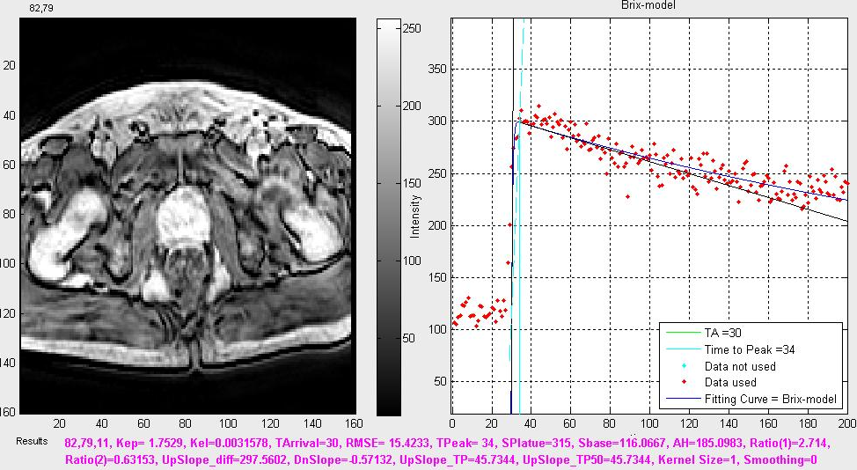
Measurement of parameters
4D analyzer (matlab based)

Slide 9
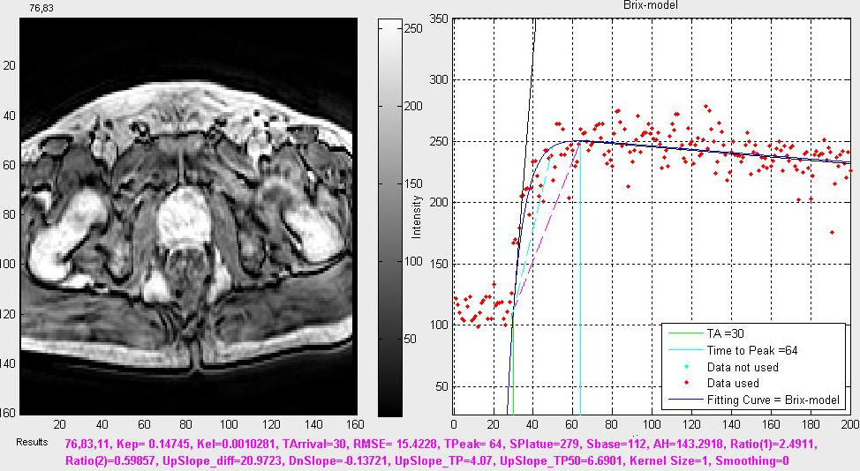
Measurement of parameters
Normal peripheral zone

Slide 10
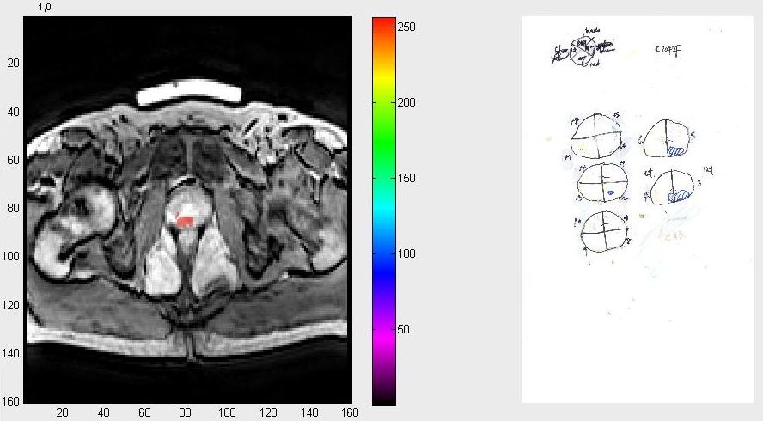
Volumetric classification result

Slide 11
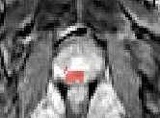
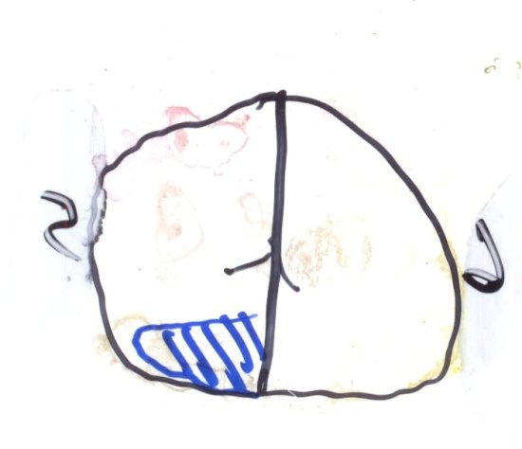
Volumetric classification result

Slide 12
Comparing with prostate segment result
Prostate Cancer vs. Noncancer
* Generalized Estimating Equations
 | Automated classifier | T2WI | p-value*
Sensitivity | 86% (132/153) | 66% (101/153) | p=0.004
Specificity | 88% (289/327) | 75% (244/327) | p=0.002
Accuracy | 88% (421/480) | 72% (345/480) | p<0.01

Slide 13
Thank You !
Notes:
Thank you for your attention.

